Slide 1
Microsoft Machine Learning & Data Science Summit
September 26 – 27 | Atlanta, GA

Slide 2
‘Spilling’ Your Data into Azure Data Lake: Patterns & How-tos
Jason Chen
Principal Program Manager

Slide 3
Content
Big Data Pipeline and Workflow
Azure Data Lake Overview
Data Ingestion
Tools & How-to
Patterns, scenarios, considerations
Data Workflow
Patterns
Demo
Ingest data using Azure Data Factory

Slide 4
Big Data Pipeline and Workflow

Slide 5
Big Data Pipeline and Workflow
Ingestion
Discovery
Business apps
Bulk Ingestion
Preparation, Analytics and Machine Learning
Visualization
People
Custom apps
Sensors and devices
Event Ingestion
Big Data Store
DATA
INTELLIGENCE
ACTION

Slide 6

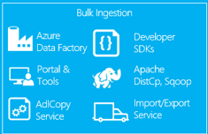

Big Data Pipeline and Data Flow in Azure
Ingestion
Preparation, Analytics and Machine Learning
Discovery
Bulk Ingestion
Azure
Data Catalog
Business apps
Machine Learning
Data Lake Analytics
Visualization
HDInsight
(Hadoop and Spark)
People
Custom apps
Power BI
Stream Analytics
Event Ingestion
Sensors and devices
Azure Data Lake Store
DATA
INTELLIGENCE
ACTION

Slide 7
Azure Data Lake: Overview

Slide 8
No limits to SCALE
Store ANY DATA in its native format
HADOOP FILE SYSTEM (HDFS) for the cloud
Optimized for analytic workload PERFORMANCE
ENTERPRISE GRADE authentication, access control, audit, encryption at rest
Introducing ADLS
Azure Data Lake Store
A hyper scale repository for big data analytics workloads

Slide 9
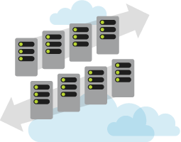
No limits to scale
No fixed limits on:
Amount of data stored
How long data can be stored
Number of files
Size of the individual files
Ingestion/egress throughput
Seamlessly scales from a few KBs to several PBs

Slide 10
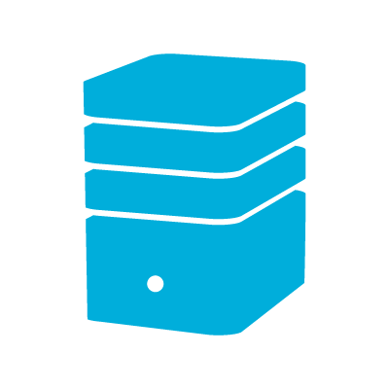
No limits to storage
Each file in ADL Store is sliced into blocks
Blocks are distributed across multiple data nodes in the backend storage system
With sufficient number of backend storage data nodes, files of any size can be stored
Backend storage runs in the Azure cloud which has virtually unlimited resources
Metadata is stored about each file No limit to metadata either.
Azure Data Lake Store file
Block 1
Block 2
…
Block 2
Backend Storage
Data node
Data node
Data node
Data node
Data node
Data node
Block
Block
Block
Block
Block
Block

Slide 11

Massive throughput
Through read parallelism ADL Store provides massive throughput
Each read operation on a ADL Store file results in multiple read operations executed in parallel against the backend storage data nodes
Read operation
Azure Data Lake Store file
Block 1
Block 2
…
Block 2
Backend storage
Data node
Data node
Data node
Data node
Data node
Data node
Block
Block
Block
Block
Block
Block

Slide 12

HDFS-compatible
With a WebHDFS endpoint Azure Data Lake Store is a Hadoop-compatible file system that integrates seamlessly with Azure HDInsight
Map reduce
Hive query
HBase transactions
Any HDFS application
Azure HDInsight
Hadoop WebHDFS client
Hadoop WebHDFS client
WebHDFS-compatible interface
Azure Data Lake Store
ADL Store file
ADL Store file
ADL Store file
ADL Store file
ADL Store file

Slide 13




A highly scalable, distributed, parallel file system in the cloud specifically designed to work with multiple analytic frameworks
Analytics on any data, any size
Devices
Social
ADL Analytics
LOB Applications
Video
ADLS
HDInsight
R
Web
Sensors
Spark
Relational
Clickstream
Machine Learning

Slide 14
Enterprise grade security
Enterprise-grade security permits even sensitive data to be stored securely
Regulatory compliance can be enforced
Integrates with Azure Active Directory for authentication
Data is encrypted at rest and in flight
POSIX-style permissions on files and directories
Audit logs for all operations

Slide 15
Enterprise grade availability and reliability
Azure maintains 3 replicas of each data object per region across three fault and upgrade domains
Each create or append operation on a replica is replicated to other two
Writes are committed to application only after all replicas are successfully updated
Read operations can go against any replica
Provides ‘read-after-write’ consistency
Data is never lost or unavailable even under failures
Write
Commit
Replica 1
Fault/upgrade domains
Replication
Replication
Replica 2
Replica 3

Slide 16
Data Ingestion: how to

Slide 17
ADLS: Tools for data ingestion
Azure Portal
Easy to use
Good for small amount of data
Analyzing data using Portal
PowerShell
Upload file and folders
Control parallelism
Control format of upload
Need to use other services
Data on your desktop
ADL Tools for Visual Studio
Integrated experience
Drag-and-drop
Programmatic
Analytics
CLI
Linux, Mac
Most features of PowerShell
Azure Data Factory
Copy Wizard for intuitive one-time copy from multiple sources
Data located in other stores
AdlCopy
Copy data easily from Azure Storage at least cost
OSS tools on HDI
Distcp, Sqoop on HDI cluster
If analyzing data using HDInsight

Slide 18


ADLS: Ingress
Data can be ingested into Azure Data Lake Store from a variety of sources
SQL
Configure HdfsBolt
Azure SQL DB
HDI Storm
ADL built-in copy service
Azure Data Factory
Azure Data Factory
Azure Storage Blobs
Azure SQL DW
ADL Store
.NET SDK
JavaScript CLI
Azure Portal
Azure PowerShell
Table Storage
Azure tables
Azure Stream Analytics
On-premises databases
Azure Event Hub
Custom programs

Slide 19
ADLS: Move really large datasets
Azure ExpressRoute
Dedicated private connections
Supported bandwidth up to 10Gbps
"Offline“
Azure Import/Export service
Data is first uploaded to Azure Storage Blobs
Use Azure Data Factory or AdlCopy to copy data from Azure Storage Blobs to Data Lake Store

Slide 20
AdlCopy
A command line tool
Copy data
Azure Storage Blobs <==>Azure Data Lake Store
Azure Data Lake Store <==>Azure Data Lake Store
Run in two ways:
Standalone
Using a Data Lake Analytics account
AdlCopy /Source <Blob source> /Dest <ADLS destination> /SourceKey <Key for Blob account> /Account <ADLA account> /Units <Number of Analytics units>

Slide 21
distcp
Copy data
M/R Hadoop job
HDInsight cluster storage <==> Data Lake Store account
hadoop distcp wasb://<container_name>@<storage_account_name>.blob.core.windows.net/example/data/gutenberg adl://<data_lake_store_account>.azuredatalakestore.net:443/myfolder

Slide 22
sqoop
Apache Sqoop is a tool designed to transfer data between relational databases and a big data repository, such as Data Lake Store.
You can use Sqoop to copy data to and from Azure SQL database into a Data Lake Store account, in addition to other other relational DBs.
More details are here.
sqoop-import --connect "jdbc:sqlserver://<sql-database-server-name>.database
.windows.net:1433;username=<username>@<sql-database-server-name>;password=
<password>;database=<sql-database-name>“ --table Table1 --target-dir adl://
<data-lake-store-name>.azuredatalakestore.net/Sqoop/SqoopImportTable1

Slide 23
Azure Data Factory
Cloud-based data integration service that orchestrates and automates the movement and transformation of data
Linked Services
Connect data factories to the resources and services you want to use
Connect to data stores like Azure Storage and on premises SQL Server
Connect to compute services like Azure ML, Azure HDI, and Azure Batch
Data Sets
A named reference/pointer to data you want to use as an input or output of an activity
Activities
Actions you perform on your data
Takes inputs and produce outputs
Pipelines
Logical grouping of activities for group operations
Compose services to transform data into actionable intelligence
AZURE DATA FACTORY
Manage and monitor
Data and operational lineage
Coordination and scheduling
Policy
DATA PIPELINES
Processing activity
Processing activity
Raw data
Orchestration and monitoring
Information
assets
LINKED SERVICES:
Data Movement from
Data processing
Data Movement to
Relational and non-relational
On-premises or cloud
Hadoop (Hive, Pig, etc.)
Data Lake Analytics
Azure Machine Learning
Stored Procedures
Custom code
Relational and non-relational
On-premises or cloud

Slide 24
ADF: Ingest / Data Movement
Globally-deployed data movement as a service infrastructure with 11 locations
Data Movement Gateway for hybrid, on premises to cloud data movement
Cloud Sources
Azure Blob
Azure Table
Azure SQL Database
Azure SQL Data Warehouse
Azure DocumentDB
Azure Data Lake Store
Cloud Sinks
Azure Blob
Azure Table
Azure SQL Database
Azure SQL Data Warehouse
Azure DocumentDB
Azure Data Lake Store
On-Premises / Azure IaaS Sources
SQL Server
File System (NTFS)
Oracle Database
MySQL Database
DB2 Database
Teradata Database
Sybase Database
PostgreSQL Database
ODBC data sources
Hadoop Distributed File System (HDFS)
On-Premises Sinks
SQL Server
File System (NTFS)

Slide 25
Ingestion - Summary
Many tools available to ingest data to ADLS
Use generic Azure tools e.g. PowerShell
Use Open Source tools e.g. DistCP
Use rich special purpose tools e.g. Azure Data Factory
Create your own tools
Pick the tool that meets your scenario requirements
Data type, sources, and location
Encoding / compression
Security
Performance
Operations: ad hoc vs. operational (schedule, event driven etc.)
Cost

Slide 26
Data Ingestion: Patterns

Slide 27
Data Migration
Scenarios:
Move on-premise HDFS to ADLS
Move on-premise RMDBS to ADLS
Move S3 data to ADLS
Solution:
Compatibility check: can all the items in the source be represented in the target
Move objects: files, tables, views, triggers, configurations, etc.
1-time bulk move data from source to destination
Run a delta-flow from source to destination so the destination keeps up-to-date with the source
Move apps, flows, etc. to target the destination system & stop the delta flows in lock step
Decommission the source storage system
Tools:
Sqoop, Azcopy, ADF

Slide 28

Global retailer moving decision support system to the Cloud
Ingestion Requirement
Data is streamed from enterprise data sources into an On Prem HDFS setup; 100s of TB in size
Data is then uploaded to ADLS
Don’t install software on-premise
Solution
Uploading data in bulk in two steps. First to WAS using AzCopy and then to ADLS using ADF
Consideration
Not creating new tools
Ease of use

Slide 29

Data Migration: for a global retailer
ON PREMISES
CLOUD
CONSUMPTION
Data cleansing
Data analysis
Relational DB
On Prem HDFS
Web Portals
Azure DW
Azure Data Factory
Power BI
Active Incoming Data

Slide 30

Data Migration: for a global retailer
ON PREMISES
CLOUD
CONSUMPTION
Data Lake Store
Massive Archive
Of Retail POS Data
Web Portals
Initial one time import
Data Lake Store
Ingestion Location
Once ingested, schedule movement to Permanent stores and processing jobs to create structured data
DW (multiple instances)
On-Prem HDFS
Data Lake Analytics
Mobile Apps
Move to cloud via AzCopy
Or ADF
Data is portioned into multiple SQL DWs for consumption by suppliers
Incremental
updates
Structured data created here. Schematized and optimized for queries
Power BI
Experimentation
Daily POS Data
A/B testing at scale. Drive changes based on actual
Customer behavior
Machine Learning at Scale (Customer Segmentation & Fraud Detection)
Notebooks

Slide 31
Event / Schedule Driven Flow
Scenarios:
Execute ingestion only when certain event occurs, e.g. new files arrived, DB activities, etc.
Solution:
Custom tools for monitoring events in data sources using Java / .NET SDK
Dynamically create ADF datasets, activities / pipelines, i.e. create the JSON needed for Data Factory and then send it to Data Factory for execution
ADF for scheduling activity and moving data based on schedule
Provide status and management of the pipeline
Supports callback to indicate status
Supports manipulation steps (e.g. run Hive) and resource mgmt. steps for extra data transformation, e.g. file clean up, archive, etc.
Tools:
Java SDK, .NET SDK, ADF and REST APIs

Slide 32

Leading analytics company moving business transaction data to Cloud
Ingestion Requirement
They will be ingesting about 1 TB a week from files that are mainly FTP’d to on-prem
Files can be 200G in size
Different ingestion at different times: Monday for blob, Tuesday for db, etc.
Callback external URL to indicate ingestion complete
Reading ODBC data source in parallel because the preconfigured on-prem throttle limit
Solution
ADF
Create ADF activities, each has its own frequency of execution
A .Net activity from with a URL would be called to indicate progress of ingestion
read a single source with 10 threads
create the JSON needed for Data Factory and then send it to Data Factory for execution.

Slide 33






Event Driven: for a leading analytics company
ON PREMISES
CLOUD
CONSUMPTION
1 – Physical validation
2 – Pre conversion
3 – Refine data
4 – HDI jobs
FTP (file share)
Watcher & Rules Engine
Relational DB
Web Portals
Other data
Google Docs
Azure DW
Power BI
Partners (Cloud to Cloud)
Azure Data Factory
Blob
Data Lake
* Partner grant access to data

Slide 34
IoT / Streaming
Scenarios:
Large amount of device data
High throughput
Mini batch - usually capture and process the data on an event-by-event basis in real-time, and then write the events in batches
Map incoming event data into specific partitions for the purposes of data organization
Solutions:
Event Hub -> ASA -> ADLS
HDI Storm -> ADLS
Event Hub (EventProcessorHost) -> ADLS
Tools:
EventHub, IoT Hub, Kafka, Storm, ASA

Slide 35


Manufacturer / IoT customer streaming device data to the Cloud for predictive maintenance
Ingestion Requirement
~60 Million persists a day
~80 Gigabytes a day
~250 persists per second
Solution
Device data to Event Hub to Storm to ADLS
HDI/Hive
Consideration

Slide 36
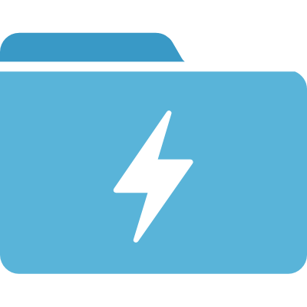

Streaming: for a global device manufacturer
Field
CLOUD
CONSUMPTION
Event data
Enriching
Event data
Azure Event Hubs
HDI Storm
Data Lake
Store
HDI R
Jupyter
Data Science
Notebooks
Event data

Slide 37

Streaming: alternative
Field
CLOUD
CONSUMPTION
Event data
Enriching
Event data
HDI Storm
Data Lake
Store
HDI R
Kafka
Jupyter
Data Science
Notebooks
Event data

Slide 38
Data Workflow: Patterns

Slide 39

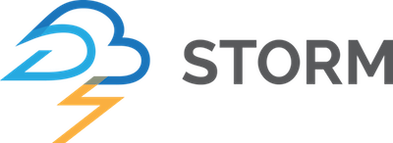


Event Ingestion
Power BI
Real Time Dashboards
Business apps
Azure
Stream Analytics
Azure Event Hubs
Events
Transformed Data
Events
Custom apps
Kafka
Spark Streaming
Event Collection
Stream Processing
Sensors and devices
Raw Events
Azure Data Lake Store

Slide 40


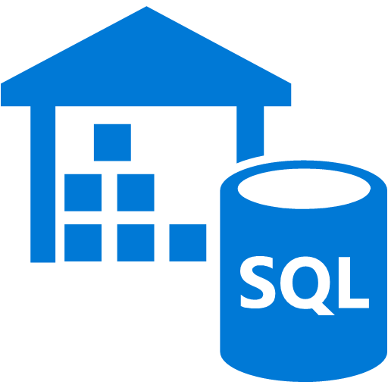
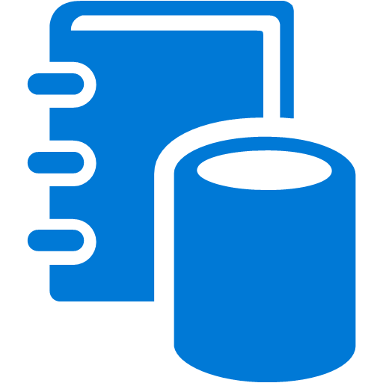
Batch Ingestion and Preparation
Power BI
Notebooks
Interactive Analytics
Data Preparation
Batch Analytics
Spark on HDInsight
Business apps
Bulk Load
Raw Data
Prepared Data (Unstructured)
Azure SQL DW
Custom apps
Prepared Data (Structured)
Azure Data Lake Store
Azure Data Catalog
Sensors and devices
Azure Data Factory

Slide 41
Demo
Ingest data to ADLS using ADF

Slide 42
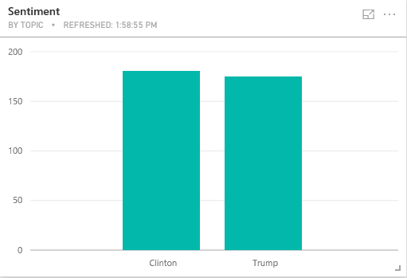
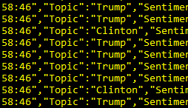
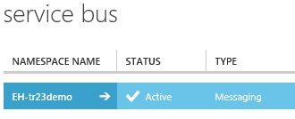
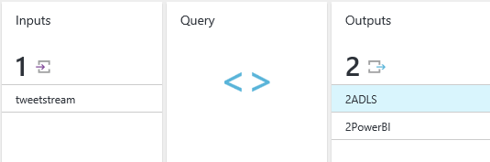
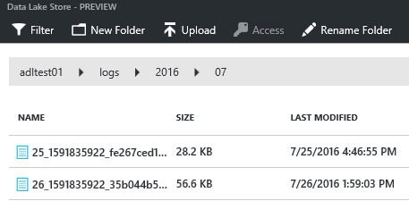
Demo: Event Ingestion Patterns
Power BI Real Time Dashboards
Azure
Stream Analytics
Event Hubs
Events
Events
Transformed Data
Event Collection
Stream Processing
Azure Data Lake Store
Use ADLS for store streaming data
Hyper scale, performant store for high speed, high volume data, with various formats
First class connectors to ASA
Control folder layout and file format
Raw Events

Slide 44
Management and Orchestration
First-class support for ADLS
Support variety of endpoints
WASB, OnPrem, Relational DB
Integrated with Analytic tools
Programmatic customization
Azure Data Factory
Out-of-the-box tools
OSS tools
Use Oozie & Falcon on HDI to manage
Use Storm for streaming data from Eventhub / Kafka into ADLS
PowerShell
Use built-in commandlets
Use PowerShell Workflow Runbooks to manage
Use PowerShell Script Runbooks to manage
ADLS SDK
Available in various languages (.NET, Java, Node.js, ..)
Upload from distributed sources e.g. server logs
ADF can be used to manage .NET apps
Custom & LOB Apps
REST APIs
For unsupported languages and platforms
Will need custom apps for orchestration

Slide 45
Bulk Ingestion and Preparation
Power BI
Notebooks
Interactive Analytics
Data Preparation
Batch Analytics
Spark on HDInsight
Business apps
Bulk Load
Raw Data
Prepared Data (Unstructured)
Azure SQL DW
Custom apps
Prepared Data (Structured)
Azure Data Lake Store
Azure Data Catalog
Sensors and devices
Azure Data Factory

